Slide 1
Parallel Databases

Slide 2
Introduction to Parallel Databases
Companies need to handle huge amount of data with high data transfer rate.
The client server and centralized system is not much efficient.
The need to improve the efficiency gave birth to the concept of Parallel Databases.
Parallel database system improves performance of data processing using multiple resources in parallel, like multiple CPU and disks are used parallely.
It also performs many parallelization operations like, data loading and query processing.

Slide 3
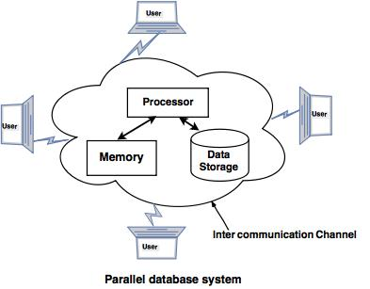
Parallel Database System

Slide 4
Goals of Parallel Databases
Improve performance: The performance of the system can be improved by connecting multiple CPU and disks in parallel. Many small processors can also be connected in parallel.
Improve availability of data: Data can be copied to multiple locations to improve the availability of data. For example: if a module contains a relation (table in database) which is unavailable then it is important to make it available from another module.
Improve reliability: Reliability of system is improved with completeness, accuracy and availability of data.
Provide distributed access of data: Companies having many branches in multiple cities can access data with the help of parallel database system.

Slide 5
Parallel Database Architecture
Shared memory system
Shared Disk System
Shared nothing disk system
Hierarchical System or Non-Uniform Memory Architecture

Slide 6
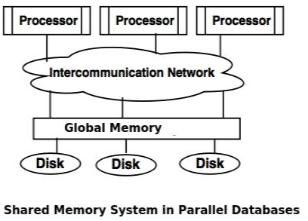
Shared memory system in Parallel Database
Shared memory system uses multiple processors which is attached to a global shared memory via intercommunication channel or communication bus.
Shared memory system have large amount of cache memory at each processors, so referencing of the shared memory is avoided.
If a processor performs a write operation to memory location, the data should be updated or removed from that location.

Slide 7
Shared memory system in Parallel Database
Advantages of Shared memory system
Data is easily accessible to any processor.
One processor can send message to other efficiently.
Disadvantages of Shared memory system
Waiting time of processors is increased due to more number of processors.
Bandwidth problem.

Slide 8
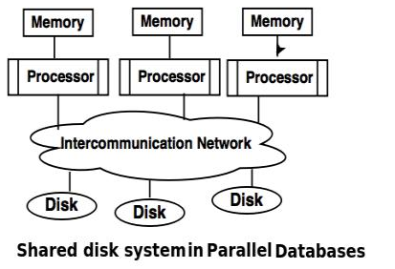
Shared Disk System in Parallel Databases
Shared disk system uses multiple processors which are accessible to multiple disks via intercommunication channel and every processor has local memory.
Each processor has its own memory so the data sharing is efficient.
The system built around this system are called as clusters.

Slide 9
Shared Disk System in Parallel Databases
Advantages of Shared Disk System
Fault tolerance is achieved using shared disk system.
Fault tolerance: If a processor or its memory fails, the other processor can complete the task. This is called as fault tolerance.
Disadvantage of Shared Disk System
Shared disk system has limited scalability as large amount of data travels through the interconnection channel.
If more processors are added the existing processors are slowed down.
Applications of Shared Disk System Digital Equipment Corporation(DEC): DEC cluster running relational databases use the shared disk system and now owned by Oracle.

Slide 10
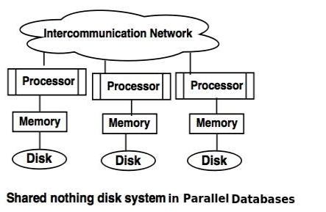
Shared Nothing Disk System in Parallel Databases
Each processor in the shared nothing system has its own local memory and local disk.
Processors can communicate with each other through intercommunication channel.
Any processor can act as a server to serve the data which is stored on local disk.

Slide 11
Shared Nothing Disk System in Parallel Databases
Advantages of Shared nothing disk system
Number of processors and disk can be connected as per the requirement in share nothing disk system.
Shared nothing disk system can support for many processor, which makes the system more scalable.
Disadvantages of Shared nothing disk system
Data partitioning is required in shared nothing disk system.
Cost of communication for accessing local disk is much higher.
Applications of Shared nothing disk system
Tera data database machine.
The Grace and Gamma research prototypes.

Slide 12
Hierarchical System or Non-Uniform Memory Architecture
Hierarchical model system is a hybrid of shared memory system, shared disk system and shared nothing system.
Hierarchical model is also known as Non-Uniform Memory Architecture (NUMA).
In this system each group of processor has a local memory. But processors from other groups can access memory which is associated with the other group in coherent.
NUMA uses local and remote memory(Memory from other group), hence it will take longer time to communicate with each other.

Slide 13
Hierarchical System or Non-Uniform Memory Architecture
Advantages of NUMA
Improves the scalability of the system.
Memory bottleneck(shortage of memory) problem is minimized in this architecture.
Disadvantages of NUMA
The cost of the architecture is higher compared to other architectures.

Slide 14
Sources of Overheads in Parallel Programs
Interprocess interactions: Processors working on any non-trivial parallel problem will need to talk to each other.
Idling: Processes may idle because of load imbalance, synchronization, or serial components.
Excess Computation: This is computation not performed by the serial version. This might be because the serial algorithm is difficult to parallelize, or that some computations are repeated across processors to minimize communication.

Slide 15
Parameters for Parallel Databases
Response time: It is the time taken to complete a single task for given time.
Speed up in Parallel database:
Speed up is the process of increasing degree of (resources) parallelism to complete a running task in less time.
The time required for running task is inversely proportional to number of resources.
Scale-up is the ability to keep performance constant, when number of process and resources increases proportionally.

Slide 16
Performance Metrics for Parallel Systems: Execution Time
Serial runtime of a program is the time elapsed between the beginning and the end of its execution on a sequential computer.
The parallel runtime is the time that elapses from the moment the first processor starts to the moment the last processor finishes execution.
We denote the serial runtime by Ts and the parallel runtime by T_{P} .

Slide 17
Performance Metrics for Parallel Systems: Total Parallel Overhead
Let T_{all} be the total time collectively spent by all the processing elements.
T_{S} is the serial time and T_{P} is the parallel runtime.
Observe that T_{all} - T_{S} is then the total time spend by all processors combined in non-useful work. This is called the total overhead.
The total time collectively spent by all the processing elements
T_{all} = p T_{P} (p is the number of processors).
The overhead function (T_{o}) is therefore given by
T_{o} = p T_{P} - T_{S}

Slide 18
Performance Metrics for Parallel Systems: Speedup
What is the benefit from parallelism?
Speedup (S) is the ratio of the time taken to solve a problem on a single processor to the time required to solve the same problem on a parallel computer with p identical processing elements.
S= T_{S} / T_{P}

Slide 19
Scalability of Parallel Systems
How do we extrapolate performance from small problems and small systems to larger problems on larger configurations?
Consider three parallel algorithms for computing an n-point Fast Fourier Transform (FFT) on 64 processing elements.
A comparison of the speedups obtained by the binary-exchange, 2-D transpose and 3-D transpose algorithms on 64 processing elements with t_{c} = 2, t_{w} = 4, t_{s} = 25, and t_{h} = 2.
Clearly, it is difficult to infer scaling characteristics from observations on small datasets on small machines.

Slide 20
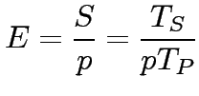

Scaling Characteristics of Parallel Programs
The efficiency of a parallel program can be written as:
or
The total overhead function T_{o} is an increasing function of p .

Slide 21
Scaling Characteristics of Parallel Programs
For a given problem size (i.e., the value of T_{S} remains constant), as we increase the number of processing elements, T_{o} increases.
The overall efficiency of the parallel program goes down. This is the case for all parallel programs.

